Slide 1
CSCI 1130
Introduction to Computing
Using Java
Tutorial 6
Midterm Revision

Slide 2
Topics
Mid-term Revision
Q & A on Assignment 3

Slide 3
Exercises
  GCD & Flow Chart Design
  Looping Exercises
  Object Creation
  Class Implementation

Slide 4
Exercise GCD
Write a Java program to accept two integers a and b from the user and find GCD(a, b).
Highest Common Factor (HCF)
Greatest Common Divisor (GCD)
Largest positive integer that divides the numbers without a remainder - from Wikipedia
  GCD of 18 and 48 is 6

Slide 5
Hint: Workflow of Finding GCD
Rules
  gcd(a, a) = gcd(a, 0) = a
  gcd(a, b) = gcd(b, a)
  gcd(a, b) = gcd(b, a mod b) , assume a>b , mod = remainder op
Idea: repeatedly reducing a & b in exchange
Example: gcd(18, 48)
= gcd(48, 18)
= gcd(18, 48 % 18) = gcd(18, 12)
= gcd(12, 18 % 12) = gcd(12, 6)
= gcd(6, 12 % 6) = gcd(6, 0) = gcd(6, 6)
= 6

Slide 6
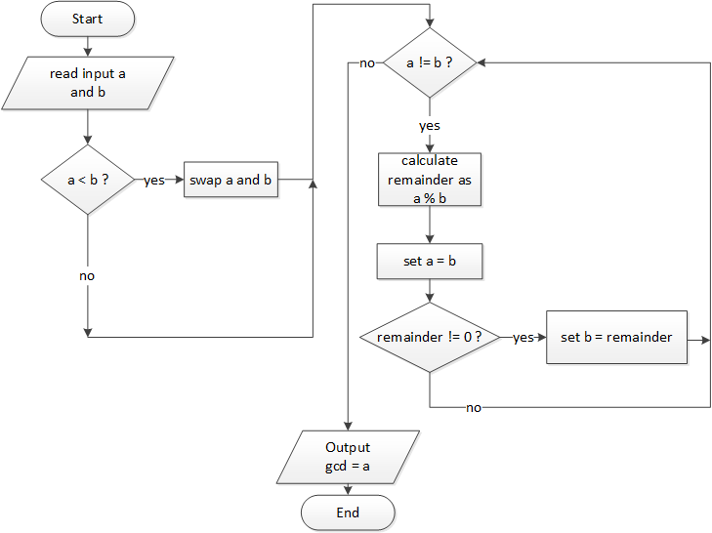
Solution: Flow chart of GCD

Slide 7
Building block → Source code
Input/Output
Conditional or decision
int a = scanner.nextInt();
int b = scanner.nextInt();
if( a < b ){
int temp = b;
b = a;
a = temp;
}

Slide 8
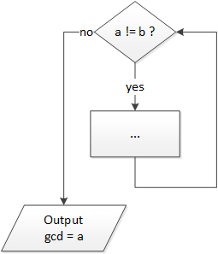
Building block → Source code
Generic processing steps
Junction
remainder = a % b;
a = b;
while( a != b && b != 0){
...
}
System.out.println("GCD = "+ a);

Slide 9
Revision: Looping Statements
while-loop
  Execution of the next iteration depends on a boolean expression
  while (condition) {
  statement-body;
  }
for-loop
  Number of iteration based on a loop-variable and counter limits
  for (init; condition; update) {
  statement-body;
  }
do-while-loop
  Similar to 'while' loop with at least one iteration guaranteed
  do {
  statement-body;
  } while (condition);

Slide 10
Exercise Triangle Printing
Write a Java program to accept an integer n from the user and print an isosceles (two-side equal) triangle of height n.
Enter n: 5
*
***
*****
*******
*********

Slide 11
Solution: Triangle Printing
Nested loop – print an isosceles triangle
int n;
System.out.print("Enter n: ");
n = scanner.nextInt();
for (int i = 0; i < n; i++){
for (int j = 0; j + 2 <= n-i; j++){
System.out.print(" ");
}
for (int k = 0; k <= i * 2; k++){
System.out.print("*");
}
System.out.println();
}
Enter n: 5
*
***
*****
*******
*********

Slide 12
Exercise Inner (Dot) Product
Given a class Vector2D
class Vector2D {
/* … private fields not shown … */
public Vector2D (int x, int y) { // Constructor
/* … details not shown … */
}
public int getX() { return x; }
public int getY() { return y; }
public double innerProduct (Vector2D v2) {
/* … details not shown …*/
}
}

Slide 13
Exercise Inner (Dot) Product
Intentions:
  ask the program user to enter four integers, representing the x, y components of two vectors
  compute the inner product between the two vectors
  print the result on the screen

Slide 14
Revision: Object Creation and Message Sending
  Object (Reference) Variable Declaration
  <classname> <variable_name>;
  Object Creation and (Reference) Assignment
  <variable_name> = new <classname>(…);
    Combined: Declaration with Initialization
    <classname> <variable_name> = new <classname>(…);
  Send Message through an Object Reference
    <variable_name>.<method_name>

Slide 15
Solution: Inner (Dot) Product
public static void main(String[] args) {
Scanner kb = new Scanner(System.in);
int x = kb.nextInt();
int y = kb.nextInt();
Vector2D v1 = new Vector2D(x, y);
x = kb.nextInt();
y = kb.nextInt();
Vector2D v2 = new Vector2D(x, y);
double result = v1.innerProduct(v2);
System.out.printf("(%d, %d) . (%d, %d) = %f\n",
v1.getX(), v1.getY(),
v2.getX(), v2.getY(), result);
}

Slide 16
Exercise Contract Employee
In a hospital, a contract employee earns a base salary every month and a one-off gratuity upon contract completion. The gratuity is a percentage of the sum of the base salaries earned during the contract period.
  E.g., base salary = $10000, gratuity rate = 0.15, contract period = 12 months;
  then annual base salary is $120000 and a gratuity of $18000 upon contract completion
In this question, we assume that the contract period of all contract employees is one year.
The record of each employee has a staff ID, a name, and a base salary.
A staff ID is a 6-digit number, which is stored as a string in the system for some reasons.
In order to calculate the earnings of a contract employee, we have to record the gratuity rate of him/her.
Following is a rough class design

Slide 17
Class ContractEmployee
Fields
  id – the staff ID of the employee
  name – the name of the employee
  baseSalary – the monthly base salary of the employee
  gratuityRate – the gratuity rate of the contract employee
Constructor
  ContractEmployee(String id, String name, double baseSalary, double gratuityrate) – initializes all the instance variables with the corresponding parameters
Instance methods
  getID() – return the staff ID of the employee
  getName() – returns the name of the employee
  getBaseSalary() – returns the base salary of the employee

Slide 18
Class ContractEmployee
Instance methods (continued…)
  isValid() – returns true if the staff ID of the employee is valid; and false otherwise. A staff ID d₀d₁d₂d₃d₄d₅ is valid if 6*d₀+5*d₁+4*d₂+3*d₃+2*d₄+d₅ is divisible by 10.
  For example, “064931” is a valid staff ID, while “287331” is not.
  annualEarnings() – calculates and returns the contract employee’s total earnings in one calendar year using his/her base salary and gratuity
  toString() – returns a string which is “contract employee “ followed by the staff ID of the contract employee and then “ “ and finally the name of the contract employee. For example, “contract employee 064931 Peter”.
In the following, you will help implement the whole class.

Slide 19
Class ContractEmployee: To Do
(a) Declare all the fields
(b) Implement the constructor
(c) Implement the method isValid()
  Hints:
    Let str be a String object, str.charAt(i) returns the character at index i of str
    The ASCII value of characters ‘0’, …, ‘9’ are 48,…,57 respectively
    the modulo operator %, which returns the remainder of a division, is useful to you.
(d) Implement the method toString()
(e) Implement the method annualEarnings(). Note that you are asked to return the annual (yearly) earnings in this method

Slide 20
Revision: Declaration of Fields and Methods (in a class {…} )
Field
  modifiers type field_name ( = …) ;
Constructor
  modifiers class_name ( parameters ) { … }
Method
  modifiers type method_name ( parameters )
  {
statements;
return expression; or return;
}

Slide 21
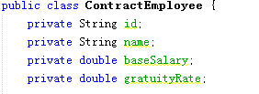
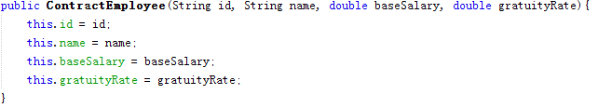
Solution: Contract Employee
(a)
(b)

Slide 22
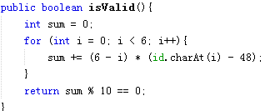


Solution: Contract Employee
(c)
(d)
(e)

Slide 23
END

